Slide 1

Threading & Multiprocessing
By Alex Joslin

Slide 2
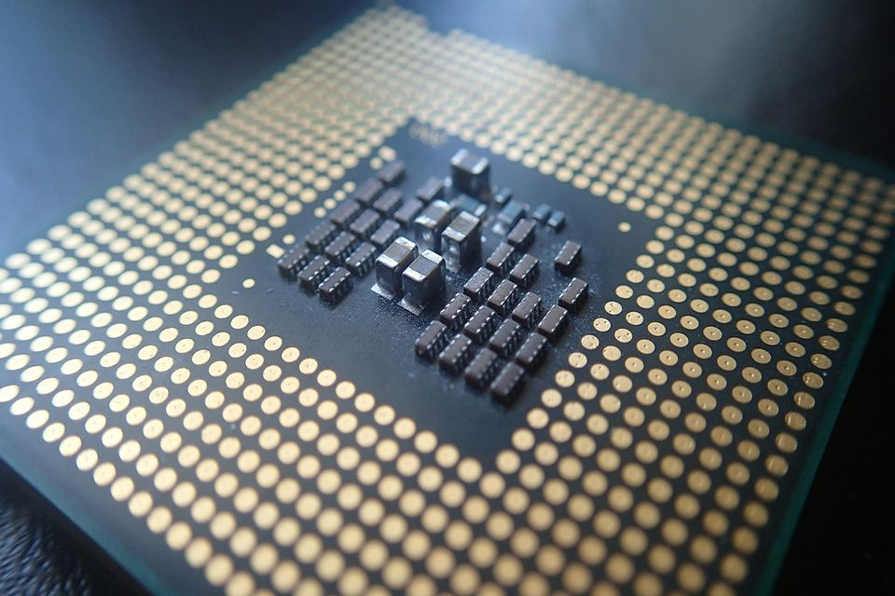
CPU Terminology
A CPU (central processing unit) also called
a processor is an electrical circuit that
executes instructions and performs basic
logical, mathematical, and I/O operations.
Cors
CPU
CPU’s have many components such as schedulers, ALU’s, clock, buses, cache, cores and many more.
A CPU core can handle one task at a time

Slide 3
What is a process?
A process is basically a program an execution. (Can be anything really)
Example: Running word, email app, photoshop on your computer.
What is a thread?
A thread is a sequence of instructions in execution
Example: You are running word and 1 thread is saving the page every 5 seconds, a 2nd thread checking grammatical errors, a 3rd thread is displaying the content on screen.

Slide 4
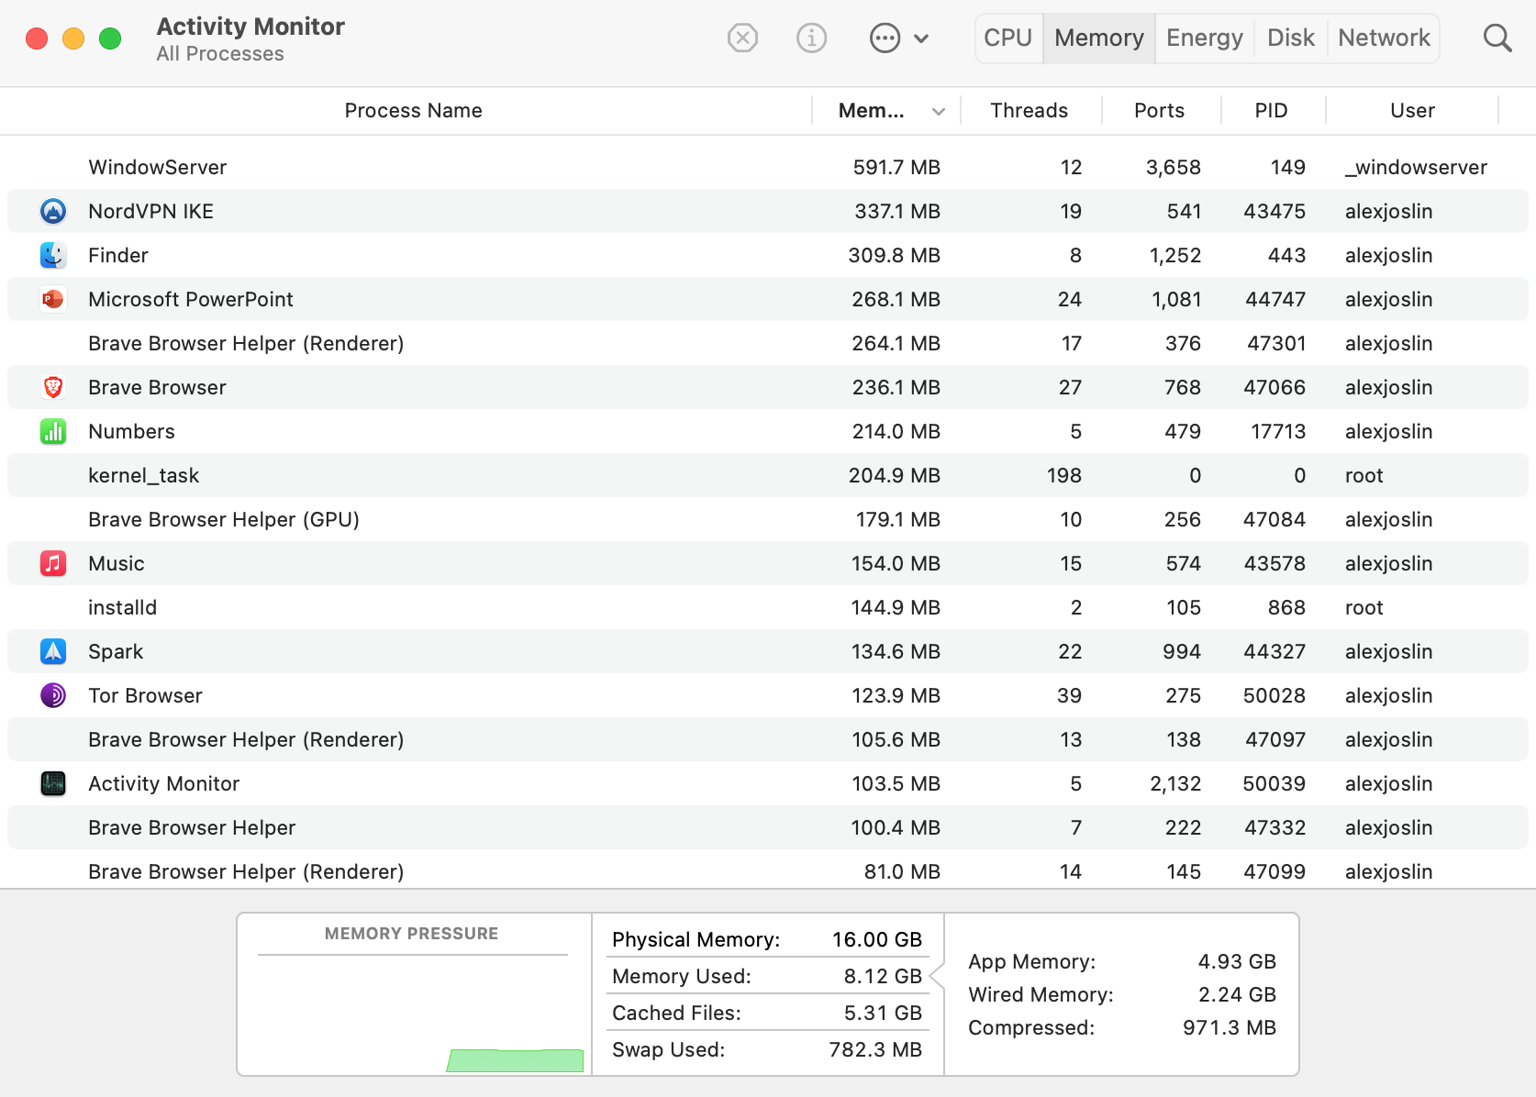
Activity Monitor on Mac

Slide 5
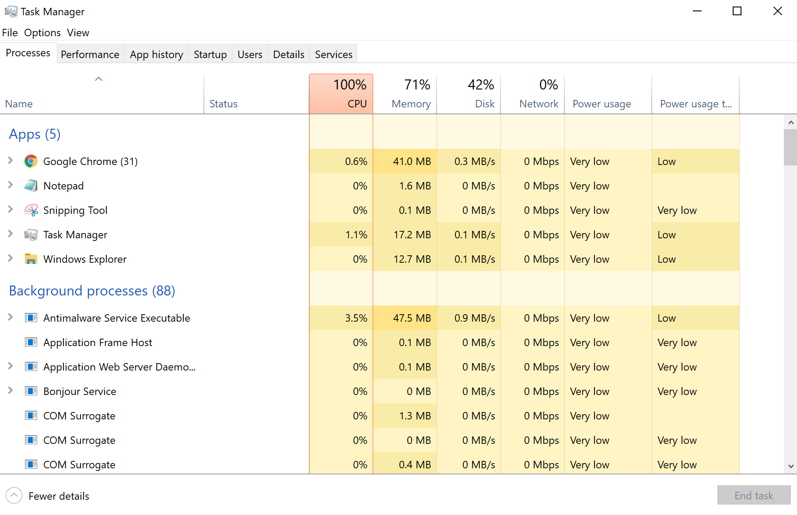
Task Manager on Windows

Slide 6
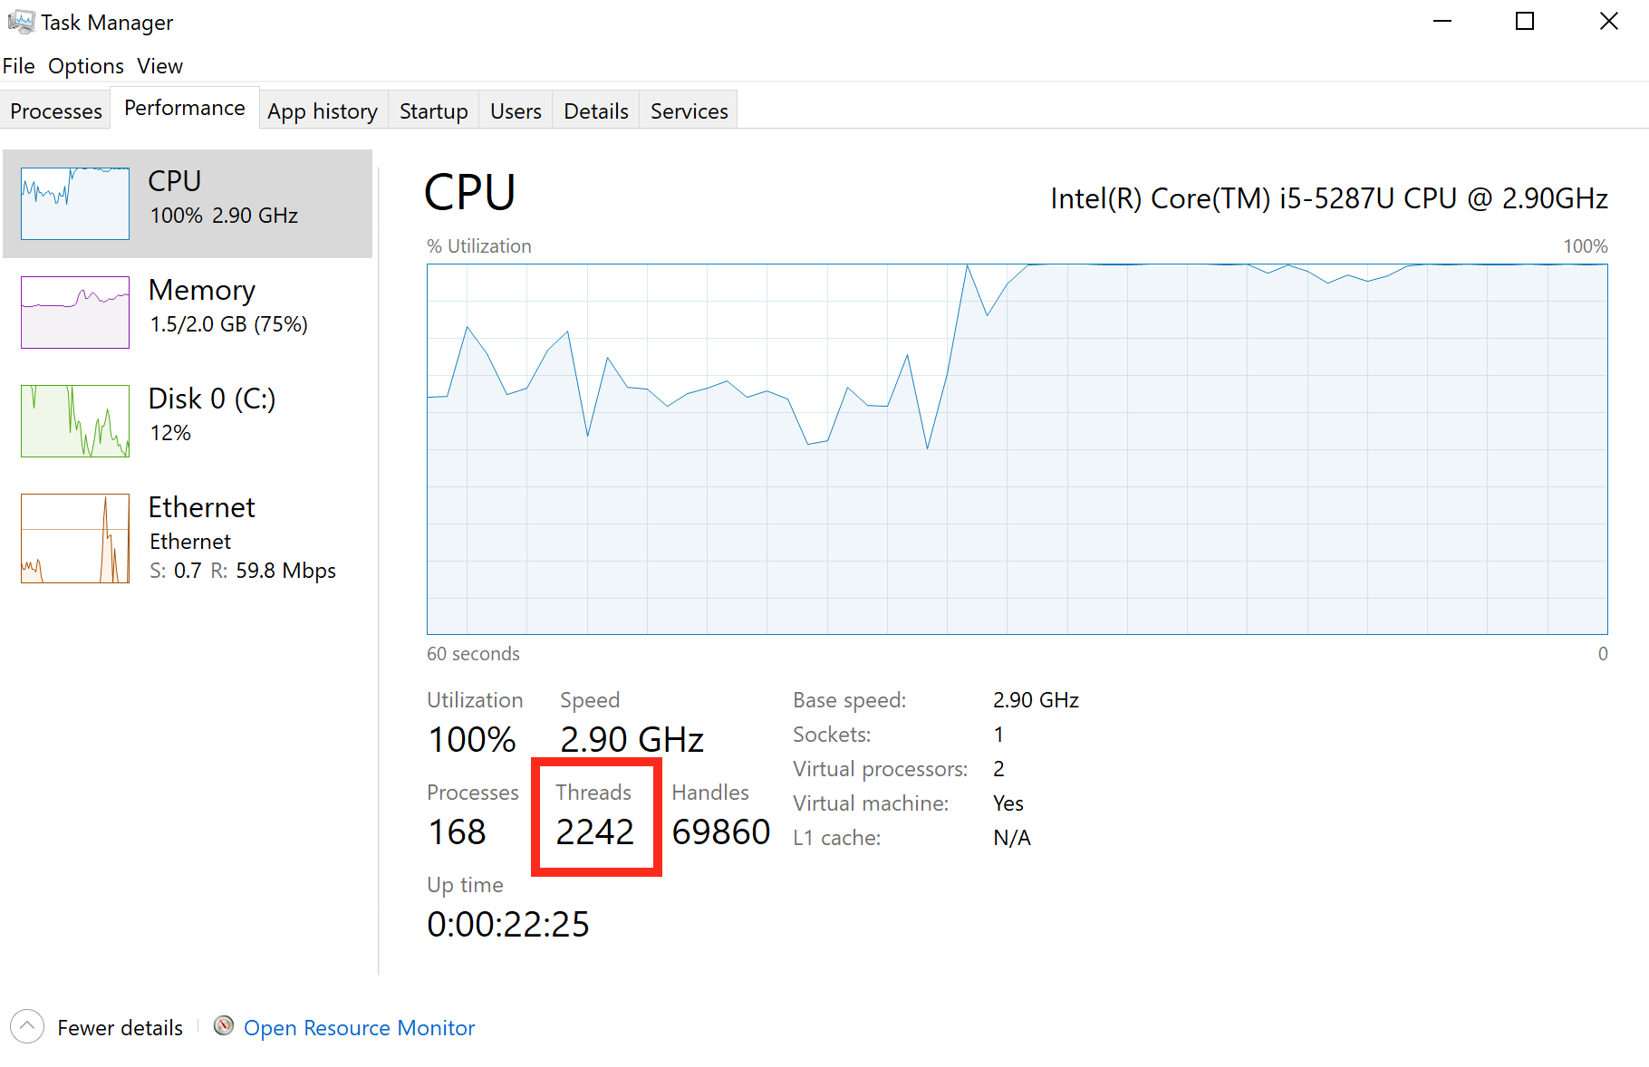
Task Manager on Windows

Slide 7
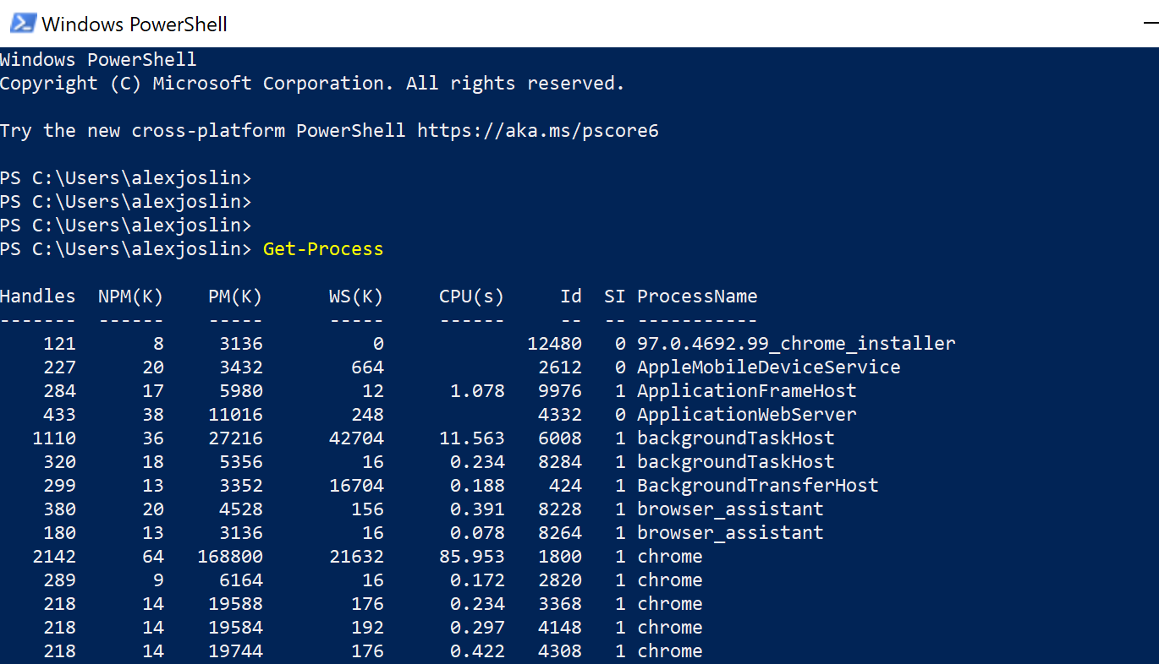
Task Manager on Windows

Slide 8
What is multiprocessing?
When a CPU executes multiple processes at the same time among its multiple cors. This is referred to as Parallelism.
What is multithreading?
When a CPU Cor executes multiple threads independently by switching back and forth between each other. This is referred to as Concurrency.

Slide 9

Threading & Multiprocessing Simulation

Slide 10
Core 1
Core 3
Remember
A process can contain multiple threads.
A core can handle at most 1 thread at a time.
A CPU with multiple cores can will distribute its processes to its cores. This is multiprocessing
Threads switch back and forth between each other within the core they are in. This is multithreading.
CPU
Core 2
Core 4
Notes:
Each core can run at most one thread at a time

Slide 11


Core 1
S
C
H
E
D
U
L
E
R
CPU
Notes:
Each core can run at most one thread at a time

Slide 12
Core 1
S
C
H
E
D
U
L
E
R
CPU
Notes:
Each core can run at most one thread at a time

Slide 13
Core 1
p1
t1
t2
t3
S
C
H
E
D
U
L
E
R
CPU
Notes:
Each core can run at most one thread at a time

Slide 14
Core 1
p1
t1
t2
t3
S
C
H
E
D
U
L
E
R
CPU
Notes:
Each core can run at most one thread at a time

Slide 15
Core 1
p2
p1
t4
t5
t1
t2
t3
S
C
H
E
D
U
L
E
R
CPU
Notes:
Each core can run at most one thread at a time

Slide 16

Core 1
Core 3
S
C
H
E
D
U
L
E
R
CPU
Core 2
Core 4
Notes:
Each core can run at most one thread at a time

Slide 17
Core 1
Core 3
S
C
H
E
D
U
L
E
R
CPU
Core 2
Core 4
Notes:
Each core can run at most one thread at a time

Slide 18
Core 1
Core 3
p1
t1
t2
t3
S
C
H
E
D
U
L
E
R
CPU
Core 2
Core 4
Notes:
Each core can run at most one thread at a time

Slide 19
Core 1
Core 3
p1
t1
t2
t3
S
C
H
E
D
U
L
E
R
CPU
Core 2
Core 4
Notes:
Each core can run at most one thread at a time

Slide 20
Core 1
Core 3
p1
t1
t2
t3
S
C
H
E
D
U
L
E
R
CPU
Core 2
Core 4
p2
t4
t5
Notes:
Each core can run at most one thread at a time

Slide 21
Core 1
Core 3
p1
t1
t2
t3
S
C
H
E
D
U
L
E
R
CPU
Core 2
Core 4
p2
t4
t5
Notes:
Each core can run at most one thread at a time

Slide 22
Core 1
Core 3
p3
p1
t5
t6
t7
t1
t2
t3
S
C
H
E
D
U
L
E
R
CPU
Core 2
Core 4
p2
t4
t5
Notes:
Each core can run at most one thread at a time

Slide 23

Printer Queue Simulation

Slide 24

Core 1
Core 3
S
C
H
E
D
U
L
E
R
CPU
Core 2
Core 4
Notes:
Each core can run at most one thread at a time

Slide 25
Core 1
Core 3
S
C
H
E
D
U
L
E
R
CPU
Core 2
Core 4
Notes:
Each core can run at most one thread at a time

Slide 26
Core 1
Core 3
t1
t2
S
C
H
E
D
U
L
E
R
CPU
Core 2
Core 4
Notes:
Each core can run at most one thread at a time

Slide 27
Core 1
Core 3
push
t1
t2
S
C
H
E
D
U
L
E
R
pop
CPU
Core 2
Core 4
Notes:
Each core can run at most one thread at a time

Slide 28

Other Information

Slide 29
Threads vs Processes
Threading | Multiprocessing
Threads are not independent from each other. They share the same memory. | Are independent from each other.
Use less memory | Use more memory
Faster to create and destroy | Slower to create and destroy
Does not run code at the same time. | Runs code at the same time.
I/O Bound | CPU Bound

Slide 30
Threads (I/O Bound) vs Processing(CPU Bound)
I/O Bound tasks: When you are waiting for input and output operations to be completed.
Examples: reading from files, downloading things online, networking requests, waiting for the completion of tasks.
CPU Bound tasks: When you are crunching a lot of numbers and need computer power.
Examples: Heavy computation, Processing Images/Video, Machine Learning, Bitcoin Mining

Slide 31
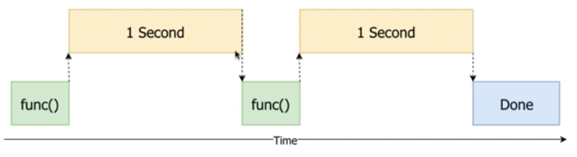
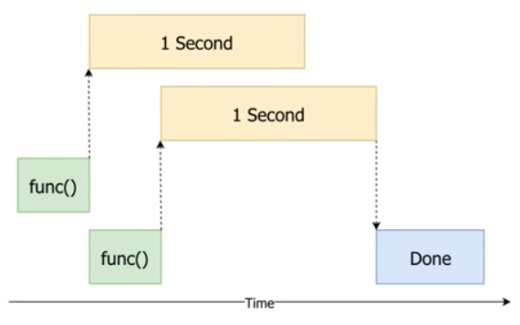
def func(): print("Sleep for 1 second") sleep(1) func() func()
thread 1
Using Threading
thread 2

Slide 32
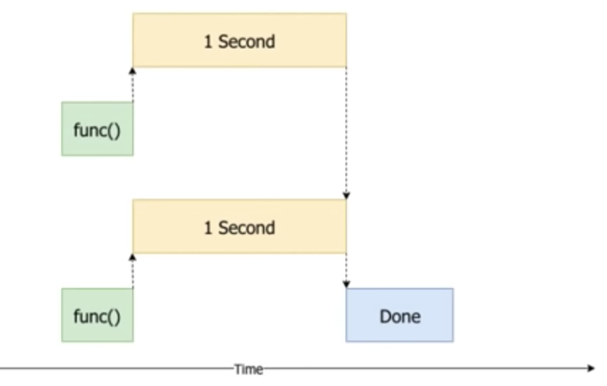
def func(): print("Sleep for 1 second") sleep(1) func() func()
process 1
Using Multiprocessing
process 2

